Slide 1
GIT COMMANDS
Aleeta Davis
UID : 166743
Trainer : Venkat B

Slide 2
git add:
git add command is used to include the changes of a file(s) into our next commit.
git add <file>
git commit:
to give messages explaining what we have developed or changed in the code.
git commit -m “commit message”
git stash : takes uncommitted changes (both staged and unstaged) and saves for later use.
git status:
gives information whether there is anything to commit, push or pull ; whether there are files staged, unstaged or untracked ; if there are files created, modified or deleted
git status

Slide 3
git branch
git branch command used for creating, listing and deleting branches.
1.creating branch :
git branch <branch-name>
2. viewing branches:
git branch or git branch –list
3. deleting a branch:
git branch -d <branch-name>
git branch -D <branch-name> (forced deletion)
4. to push the new branch into the remote repository, we need to use the following command:
git push -u <remote> <branch-name>
5. to rename branch name:
git branch -m <old name><new name>

Slide 4
git checkout :
git checkout is used for switching from one branch to another.
git checkout <name-of-branch>
to create and switch to a branch at the same time:
git checkout -b <name-of-your-branch>
git --version : gives the git version
git log --oneline : to see commit history
git merge:
merging of a branch with master or any target branch can be done using git merge . To merge a branch to master:
git checkout master
git merge <branch-name>

Slide 5
git fetch: to get or download files from another repository
git pull:
The git pull command is used to get updates from the remote repo.This command is a combination of git fetch and git merge ie it fetches from remote repository (git fetch) and immediately applies changes in the local (git merge).
git pull <remote>
git-cherry-pick : Apply the changes introduced by some existing commits.
git-diff :Show changes between commits, commit and working tree etc
git diff branch1 branch2
git-rebase:
Reapply commits on top of another base . Here we have the process of moving or combining a sequence of commits to a new base commit.
git push:
uploads our commits to the remote repository.
git push -u origin <branch_name>

Slide 6
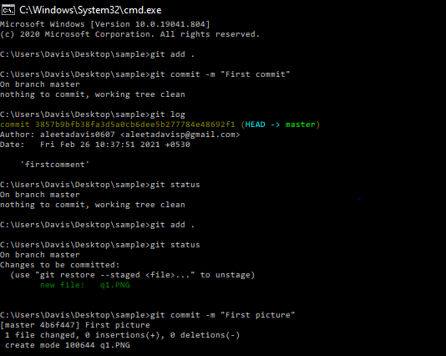
Practical Example:

Slide 7
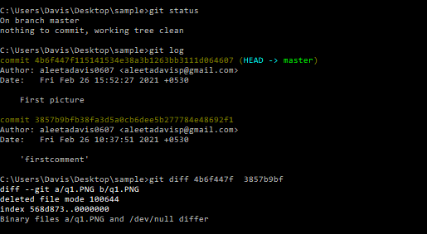
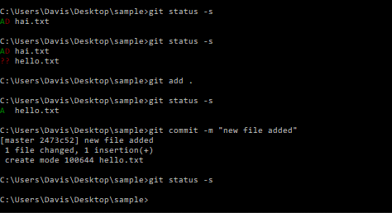

Slide 8
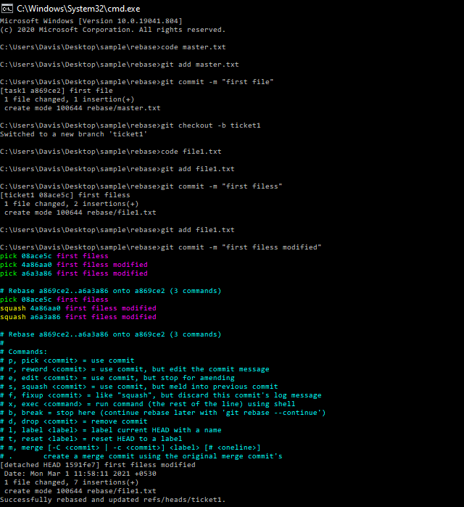
Rebase:

Slide 9
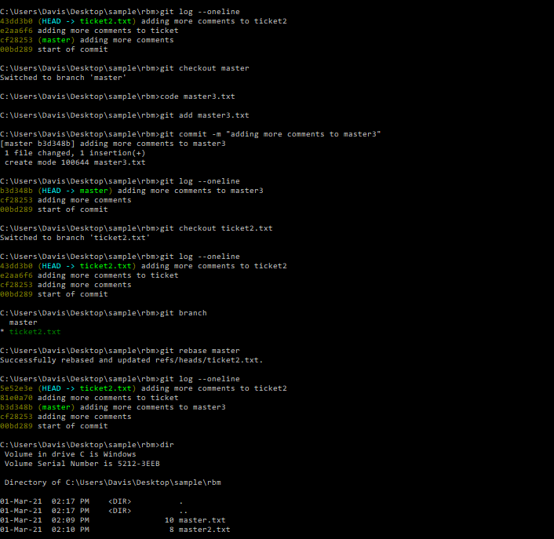
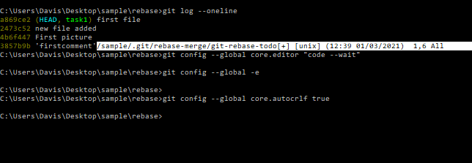

Slide 10
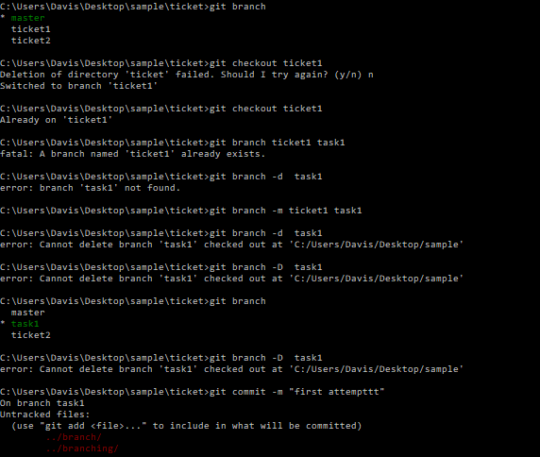
git branch

Slide 11
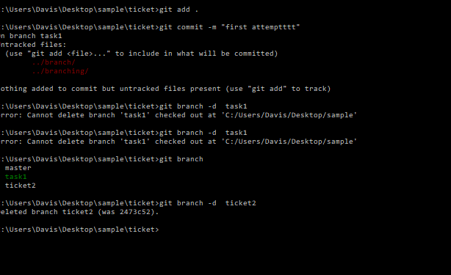

Slide 12
THANKYOU

